Slide 1
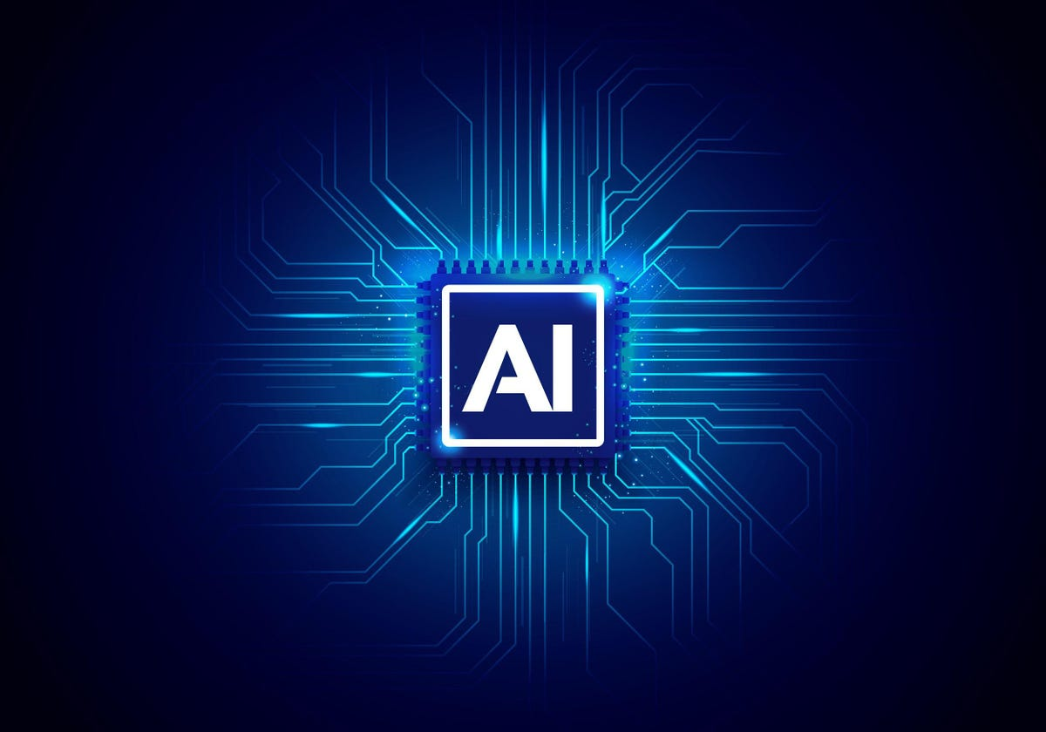
ARTIFICIAL
INTELLIGENCE

Slide 2

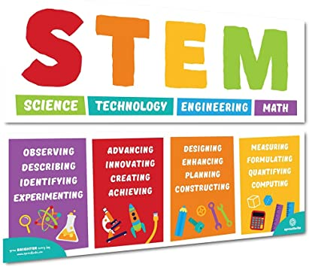

Slide 3
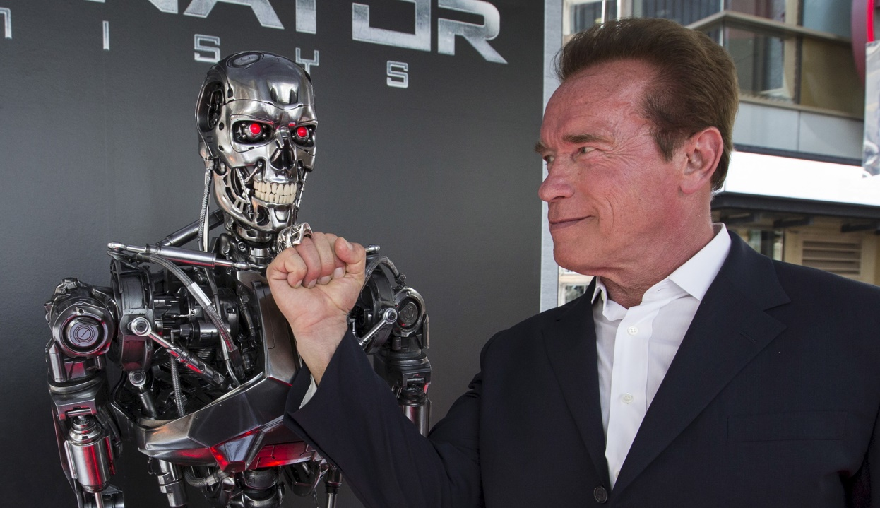
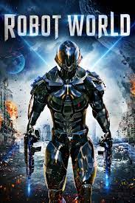
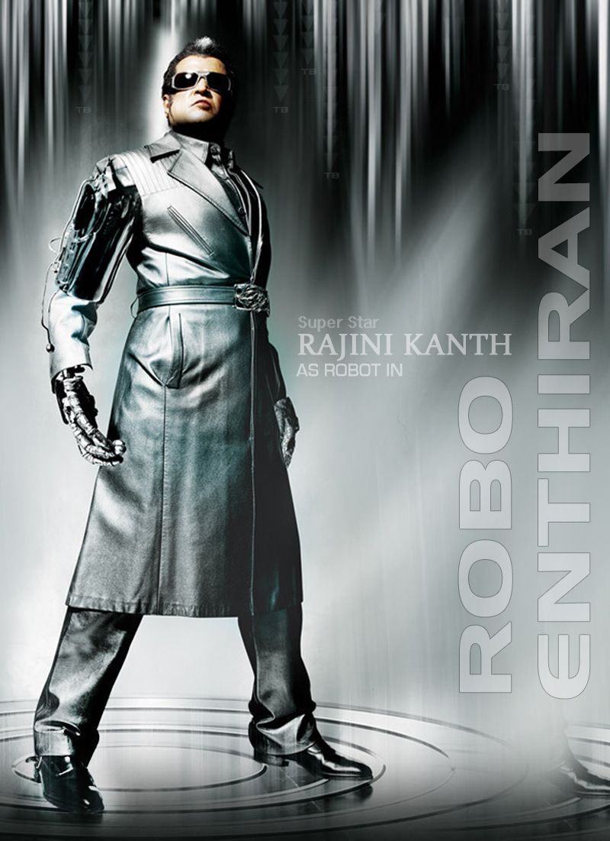
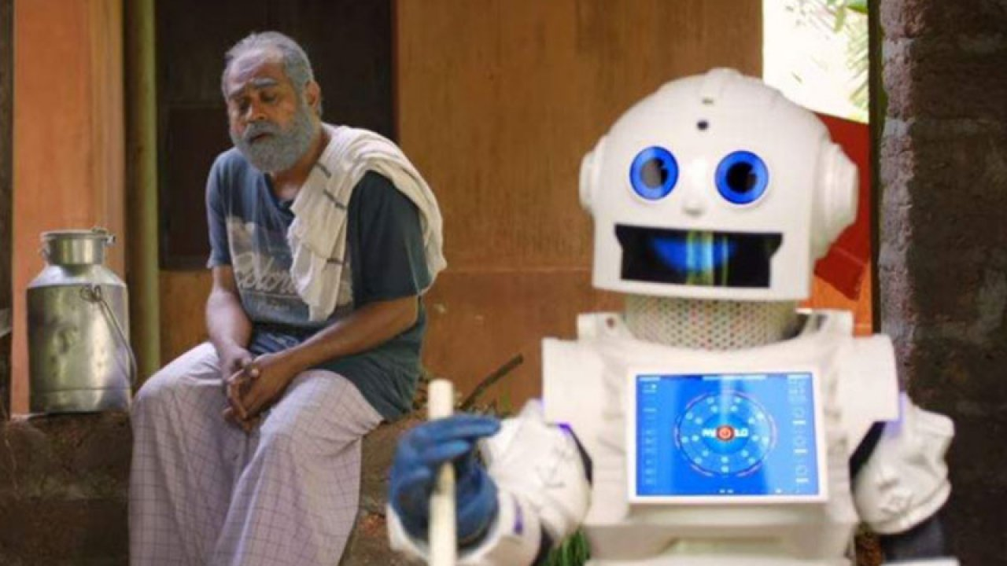

Slide 4
History of Artificial Intelligence
1950
Alan Turing –Turing Test - Possibility of creating machines that think
1951
Game AI
1956
John McCarthy(Introduced the term AI)
1959
Followed by developing a lab i.e. is MIT Lab
1960
General Motors Robot(First Robot was introduced to General motors assembly line)
1961
First Chatbot( The first AI Chatbot called ELIZA WAS INTRODUCED )
1997
IBM Deep Blue
2005
DARAA Grand Challenge
2011
IBM Watson

Slide 5
?
What is AI

Slide 6
?
What is AI
The Science and Engineering making intelligent machine.
AI is the development of computer system that are capable
of performing tasks that normally require human intelligence,
such as decision making, object detection,
solving complex problems and so on .

Slide 7
How to develop these intelligence in a machine?
Methods to train AI
AI
MACHINE
LEARNING
DEEP
LEARNING

Slide 8
MACHINE LEARNING
Supervised Learning
B
Unsupervised Learning
Reinforcement Learning
C
A

Slide 9
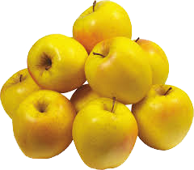
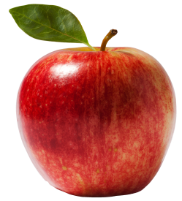
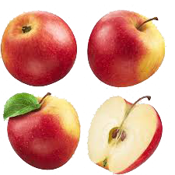
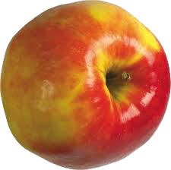
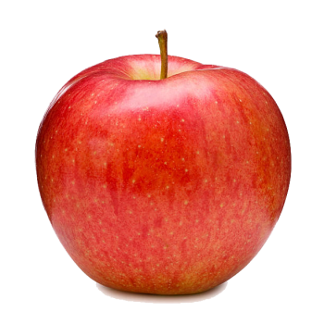
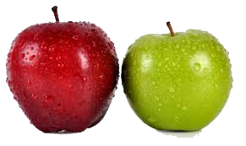
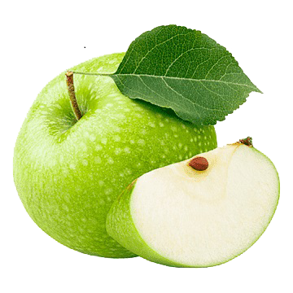
MACHINE LEARNING
Supervised Learning
1
A person trains a machine.

Slide 10
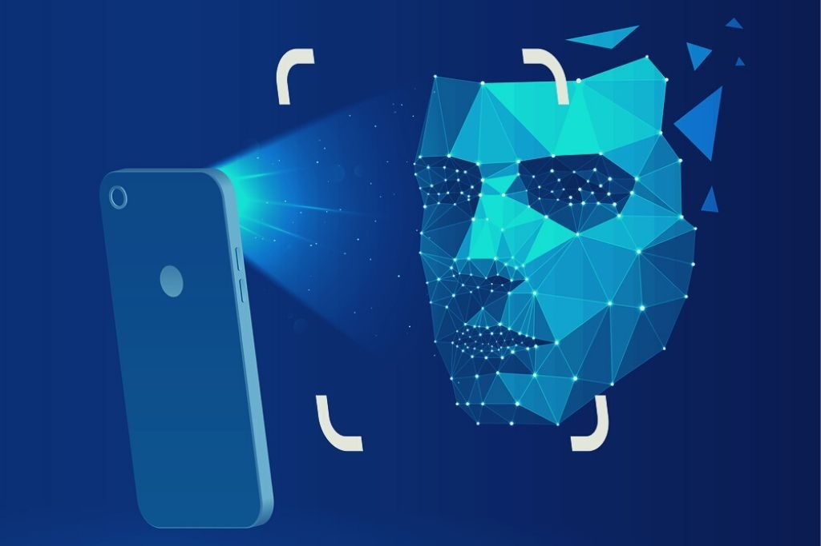
MACHINE LEARNING
Supervised Learning
1

Slide 11

MACHINE LEARNING
Supervised Learning
1
Finger print images

Slide 12
MACHINE LEARNING
Un supervised Learning
2
A person doesn’t train a machine.
Just giving data.
System itself create a pattern.

Slide 13
MACHINE LEARNING
Un supervised Learning
2
How to create pattern?
According to colour .
According to shape .
According to customers wish .
Etc………...

Slide 14

MACHINE LEARNING
Un supervised Learning
2
+
+

Slide 15
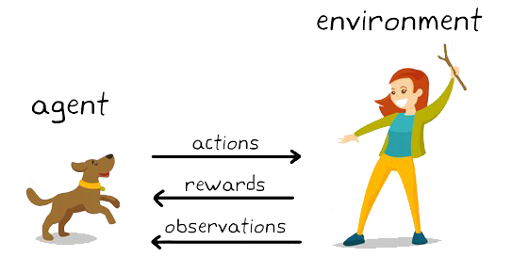
MACHINE LEARNING
Reinforcement Learning
3

Slide 16
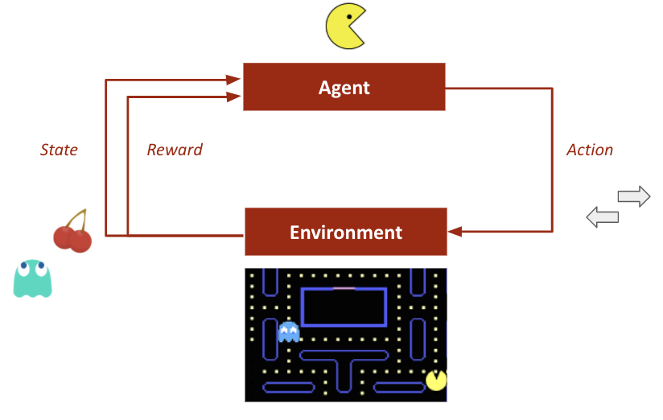
MACHINE LEARNING
Reinforcement Learning
3

Slide 17
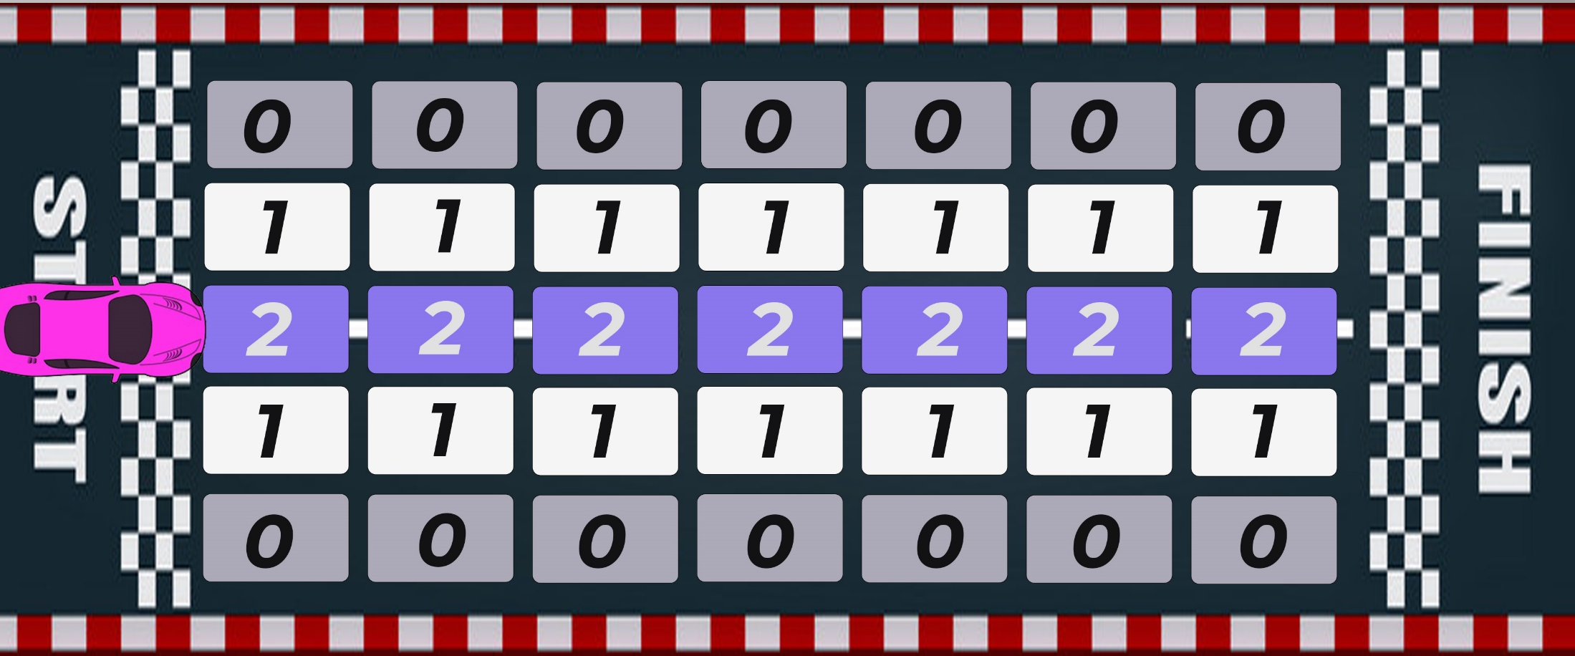
MACHINE LEARNING
Reinforcement Learning
3

Slide 18
How to develop these intelligence in a machine?
Methods to train AI
AI
MACHINE
LEARNING
DEEP
LEARNING

Slide 19
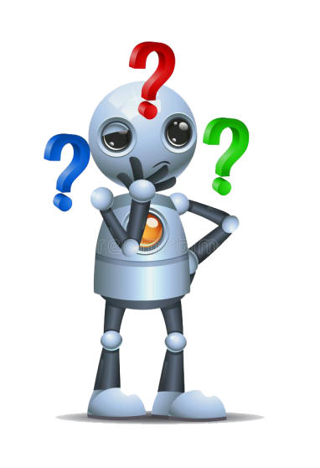
DEEP LEARNING
Machine
Learning
?
Deep
Learning

Slide 20
How it would be possible in man?
Biological Neural Network
Neural Network
Artificial Neural Network

Slide 21
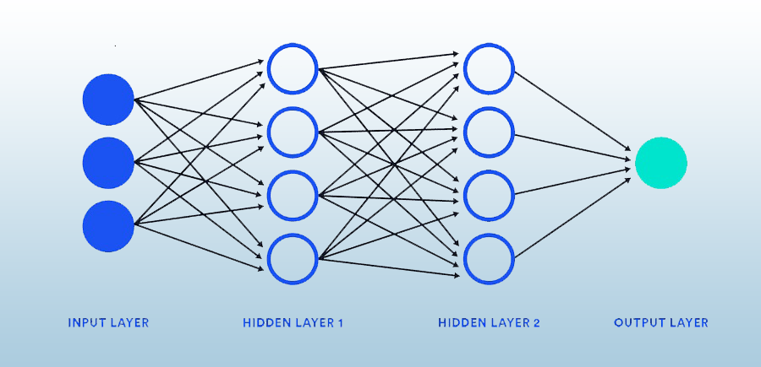
Artificial Neural Network
Face App
Lyrics and background music splitter
Speech recognition
English to Malayalam converter
Etc………..

Slide 22
Implementation of Deep learning is difficult
Powerful system is needed
Large memory is needed
Heavy cooling system is needed

Slide 23






